Slide 1
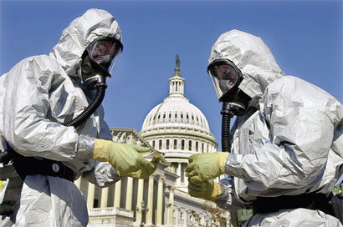
Bioterrorism

Slide 2
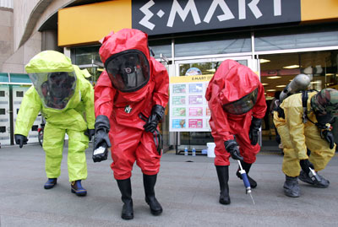
Bioterrorism
Terrorism is defined in the United States Code, Title 18, section 2331(18 USC 2331) as “Violent acts or acts dangerous to human life that…appear to be intended:
To intimidate or coerce a civilian population;
To influence the policy of a government by intimidation or coercion; or
To affect the conduct of a government by assassination or kidnapping.

Slide 3
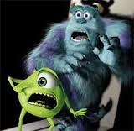
Biological weapons used in bioterrorism are living microorganisms that can kill or incapacitate such as:
bacteria
viruses
fungi

Slide 4
Health care facilities may be the initial site of recognition and response to bioterrorism activity. Because of this, the names and telephone numbers for internal and external departments or agencies that need to be contacted should be kept by each facility in its bioterrorism readiness plan.

Slide 5
Response to bioterrorism agents:
Response to bioterrorism agents:
Internal reporting requirements (within a facility):
Infection control personnel
Epidemiologist (local and state)
Administration (health care facility and health department)
Office of public affairs in the health facility

Slide 6
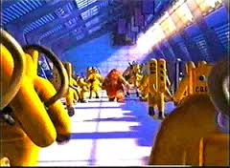
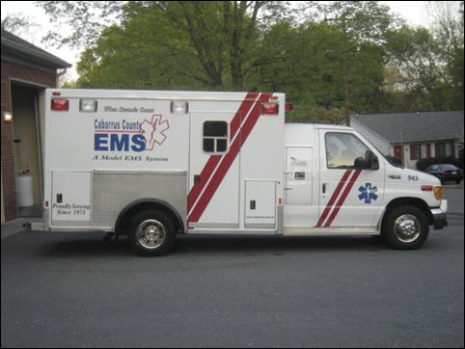
External Contacts(outside of facility)
Local health department
State Health Department
FBI Federal Bureau of Investigation
CDC Centers for Disease Control
Local police
EMS Emergency Medical Services

Slide 7
What would these agencies do?
Determine who needs immediate medical attention. (TRIAGE)
Determine who is capable of staying and being treated at home.
Teach victims at home to follow standard precautions such as hand washing, cleaning and barrier precautions. ( example wearing masks to prevent transmission)
Monitor the population for effects.
Possible immunization.

Slide 8
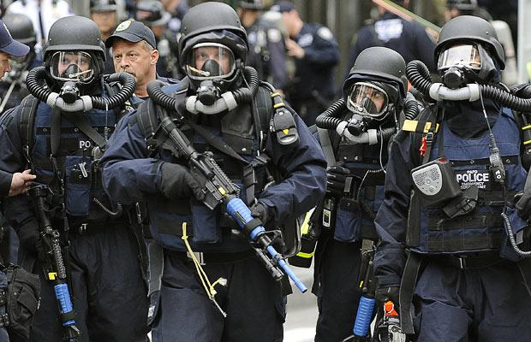
Biological Agents that may be used in terrorist acts include:
Bacterial- Anthrax and Plague
Viral- Small Pox
Toxins- Botulism and Ricin

Slide 9
Anthrax
Bacterial---Acute infectious disease caused by bacillus anthracis.
Sent through the mail to federal agencies in 2001.
Why considered a bioterrorism act?
As few as 1-3 spores of anthrax may cause an infection and it has a high fatality rate
Modes of transmission:
Inhalation of spores –attacks the lungs
Skin contact – skin and wound infection
Ingestion of contaminated food – digestive tract

Slide 10
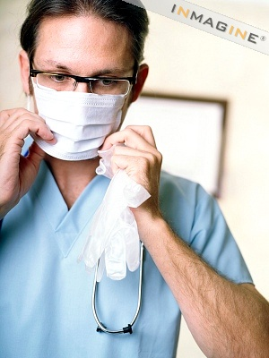
Prognosis: (outcome)
Treated with antibiotics good.
Increased death rate if not recognized early and treated quickly.

Slide 11
Plague-- Bacterial
Yersinia pestis – fleas
Signs and symptoms: fever, cough, chest pain, hemoptysis, watery sputum, bronchopneumonia
Transmission: by flea, aerosol and person to person
Incubation: 1-8 days; flea up to 8 days; aerosol up to 3 days
Prognosis: good if treated with antibiotics early

Slide 12
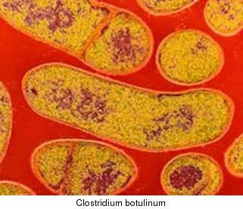
Botulism
Potent neurotoxin caused by an anaerobic bacillus- colstridium botulinum.
Transmission is eating contaminated food or inhaling the spores.
Signs and symptoms
Weakened jaw clench
Respiratory distress
Blurred vision
Difficulty swallowing and speaking

Slide 13
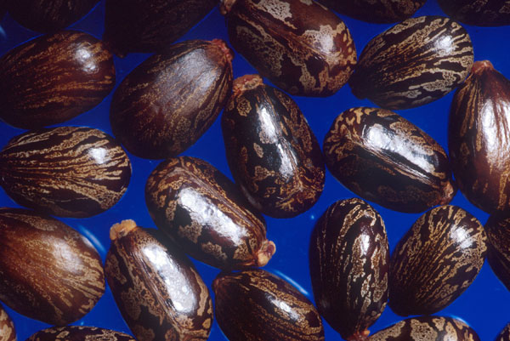
Ricin –Potent protein toxin
Castor beans are found easily all over the world and the toxin is fairly
easily produced. For this reason ricin could be used as a
biological weapon with relative ease.

Slide 14
Small Pox
Viral Agent
Mode of transmission: Airborne: droplets
Signs and symptoms:
Flu like symptoms-fever, myalgia
Skin lesions appear quickly progressing from macules to papules to vesicles
Rash scabs over in 1-2 weeks
Rash occurs in all areas at once

Slide 15
Contagious when the rash is apparent and remains infectious until scabs separate (approx. 3 weeks)
Prognosis:
Vaccine available and effective post-exposure
Passive immunization is also available in the form of vaccina- immune-globulin (Vig)
Smallpox has a high mortality rate.

Slide 16
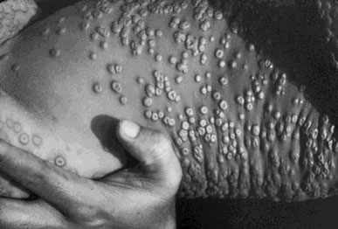

Slide 17
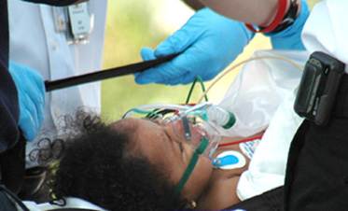
Infections in humans
Ingestion
Inhalation
Very deadly
Signs and Symptoms:
18-72 hours
Weakness
Fever
Cough
Pulmonary edema
Severe respiratory distress
Death from hypoxemia

Slide 18
Scenario
You are a nurse in the ER of your local hospital. There has been a suspicious skin infection noted in a patient room. The person presented with signs and symptoms of fever, malaise, myalgia, and vesicle formation over the entire body. The physician says it looks like smallpox.
What isolation precautions are needed?

Slide 19
How do we protect ourselves?
Use standard precautions (barrier precautions)
Wash hands, gloves, mask, gown, sanitize and clean as neccesary.
WASH YOUR HANDS!!!!!!
How long and what temperature should the water be?
What can the public do? Be knowledgeable and aware of how to protect yourself.

Slide 20
Large scale bioterrorism act
What do you do?
Open a small isolation hospital for long term care of victims
Group affected victims together
Group victims according to the “stage” of the infectious disease
Early stage
Mid stage
End stage/near death/no options

Slide 21
What about the local community??
What instructions should be given to community members that may NOT be affected YET!!!
Remain home as much as possible
Be aware, knowledgeable, and remain safe and calm
Instruct them about barrier precautions or standard precautions
Handwashing
Sanitize, disinfect and sterilize

Slide 22
What if ???
You traveled outside the US and became sick with an infectious disease? What might happen and what are your options?
What would public health officials say about your return to the US?
You can’t return until you are considered “non-infectious”
The US government will assist with proper care.

Slide 23
Death– what if it happens??
If a victim of a bioterrorism attack dies- who should be notified that it was due to a bioterrorism infectious agent?
Funeral Director
Why should he/she be told the cause of death?
To take special post-mortem precautions
What are special post mortem precautions?
Personal protective equipment (PPE)
Standard precautions: gloves, mask, eye protection
Careful of splatter of blood and body fluids- wear a gown

